Slide 1
Smart Objects: The “Things” in IoT
Module 2

Slide 2
Sensors are fundamental building blocks of IoT networks
Sensors are the foundational elements found in smart objects—the “things” in the Internet of Things
Smart objects are any physical objects that contain embedded technology to sense and/or interact with their environment in a meaningful way by being interconnected and enabling communication among themselves or an external agent.

Slide 3
SENSORS, ACTUATORS, AND SMART OBJECTS
A sensor: It senses
More specifically, a sensor measures some physical quantity and converts that measurement reading into a digital representation.
That digital representation is typically passed to another device for transformation into useful data that can be consumed by intelligent devices or humans
Sensors are not limited to human-like sensory data.
They are able to provide an extremely wide spectrum of rich and diverse measurement data with far greater precision than human senses

Slide 4
Categories
Active or passive:
Sensors can be categorized based on whether they produce an energy output and typically require an external power supply (active) or
Whether they simply receive energy and typically require no external power supply (passive).
Invasive or non-invasive:
Sensors can be categorized based on whether a sensor is part of the environment it is measuring (invasive) or
External to it (non-invasive).

Slide 5
Contact or no-contact:
Sensors can be categorized based on whether they require physical contact with what they are measuring (contact) or not (no-contact).
Absolute or relative:
Sensors can be categorized based on whether they measure on an absolute scale (absolute) or based on a difference with a fixed or variable reference value (relative).

Slide 6
Area of application:
Sensors can be categorized based on the specific industry
or vertical where they are being used.
How sensors measure:
Sensors can be categorized based on the physical mechanism used to measure sensory input (for example, thermoelectric, electrochemical, piezoresistive, optic, electric, fluid mechanic, photoelastic).

Slide 7
What sensors measure:
Sensors can be categorized based on their applications
or what physical variables they measure.
Note that this is by no means an exhaustive list, and there are many other classification and taxonomic schemes for sensors, including those based on material, cost, design, and other factors

Slide 8
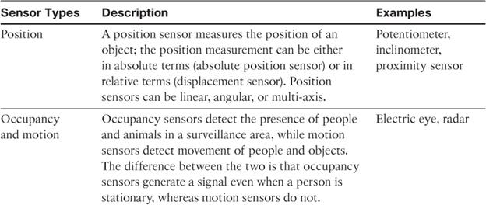
Categorization based on what physical phenomenon a sensor is measuring

Slide 9
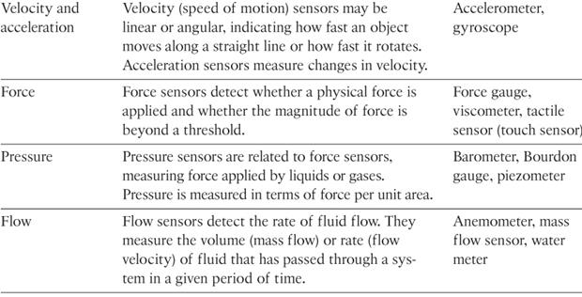
11

Slide 10
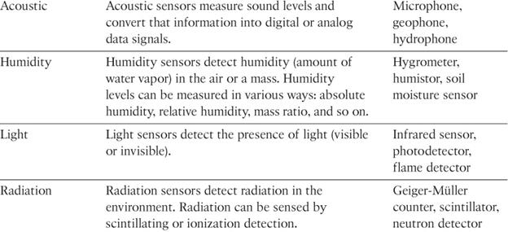

Slide 11
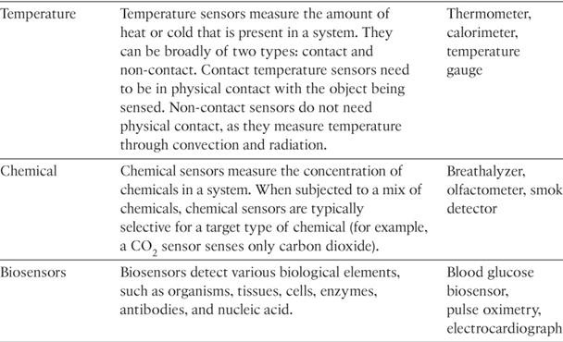

Slide 12
Precision agriculture (smart farming)
which uses a variety of technical advances to improve the efficiency, sustainability, and profitability of traditional farming practices.
This includes the use of GPS and satellite aerial imagery for determining field viability; robots for high-precision planting, harvesting, irrigation, and so on; and real-time analytics and artificial intelligence to predict optimal crop yield, weather impacts, and soil quality.
Among the most significant impacts of precision agriculture are those dealing with sensor measurement of a variety of soil characteristics. These include real- time measurement of soil quality, pH levels, salinity, toxicity levels, moisture levels for irrigation planning, nutrient levels for fertilization planning, and so on.
All this detailed sensor data can be analyzed to provide highly valuable and
actionable insight to boost productivity and crop yield.

Slide 13
IoT Use Case: Area of precision agriculture (smart farming)
biodegradable, passive microsensors to measure soil and crop and conditions
.
These sensors, developed at North Dakota State University (NDSU), can be planted directly in the soil and left in the ground to biodegrade without any harm to soil quality.

Slide 14
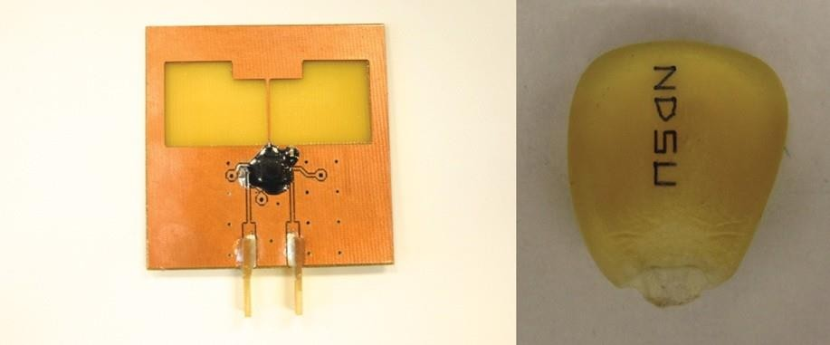
Figure 3-1 Biodegradable Sensors Developed by NDSU for Smart Farming

Slide 15
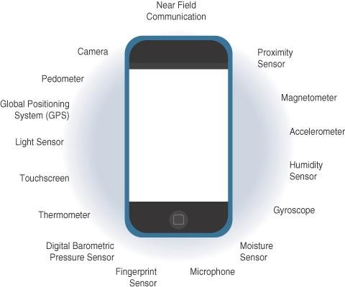
Sensors in a Smart Phone

Slide 16
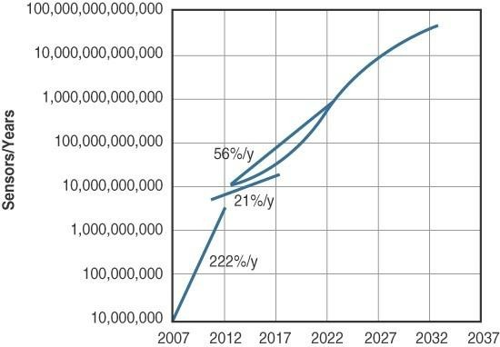
Figure 3-3 Growth and Predictions in the Number of Sensors

Slide 17
Actuators
Actuators are natural complements to sensors
Sensors are designed to sense and measure practically any measurable variable in the physical world.
They convert their measurements (typically analog) into electric signals or digital representations that can be consumed by an intelligent agent (a device or a human).
Actuators, on the others hand, receive some type of control signal (commonly an electric signal or digital command) that triggers a physical effect, usually some type of motion, force, and so on.
Sensors provide the information, actuators provide the action

Slide 18
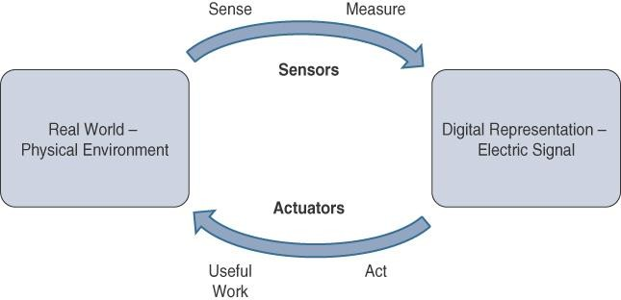

Slide 19
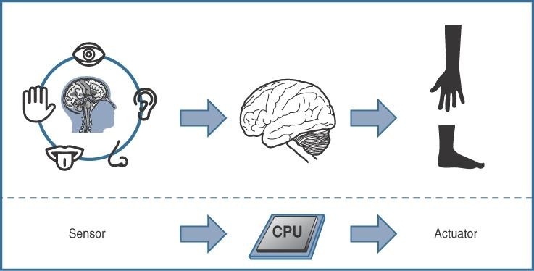

Slide 20
Actuators also vary greatly in function, size, design, and so on.
Some common ways that they can be classified include the
following:
Type of motion: Actuators can be classified based on the type of motion they produce (for example, linear, rotary, one/two/three- axes).
Power: Actuators can be classified based on their power output (for example, high power, low power, micro power)
Binary or continuous: Actuators can be classified based on the number of stable-state outputs.
Area of application: Actuators can be classified based on the
specific industry or vertical where they are used.
Type of energy: Actuators can be classified based on their energy type.

Slide 21
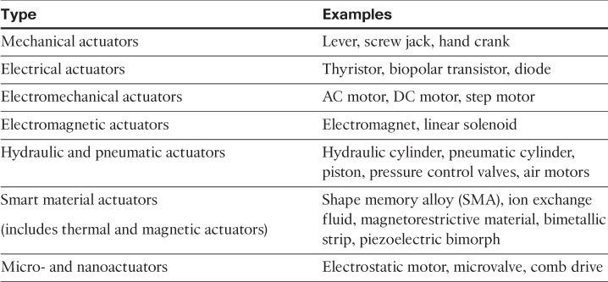
Classification based on energy type

Slide 22
Micro-Electro-Mechanical Systems (MEMS)
Interesting advances in sensor and actuator technologies is in how they are packaged and deployed.
Micro-electro-mechanical systems (MEMS), sometimes simply referred to as micro-machines, can integrate and combine electric and mechanical elements, such as sensors and actuators, on a very small (millimeter or less) scale.
One of the keys to this technology is a microfabrication technique that is similar to what is used for microelectronic integrated circuits.
This approach allows mass production at very low costs

Slide 23
The combination of tiny size, low cost, and the ability to mass produce makes MEMS an attractive option for a huge number of IoT applications.
MEMS devices have already been widely used in a variety of different applications and can be found in very familiar everyday devices.
For example, inkjet printers use micropump MEMS.
Smart phones also use MEMS technologies for things like accelerometers and gyroscopes.
In fact, automobiles were among the first to commercially introduce MEMS into the mass market, with airbag accelerometers.

Slide 24
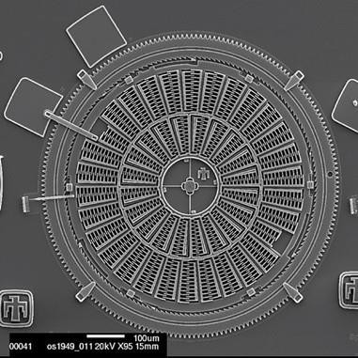
Figure 3-6 Torsional Ratcheting Actuator (TRA) MEMS (Courtesy Sandia National
Laboratories, SUMMiT™ Technologies, www.sandia.gov/mstc.)

Slide 25
Smart Objects
Smart objects are, quite simply, the building blocks of IoT.
They are what transform everyday objects into a network of intelligent objects that are able to learn from and interact with their environment in a meaningful way
The real power of smart objects in IoT comes from being networked together rather than being isolated as standalone objects

Slide 26
If a sensor is a standalone device that simply measures the humidity of the soil, it is interesting and useful, but it isn’t revolutionary
If that same sensor is connected as part of an intelligent network that is able to coordinate intelligently with actuators to trigger irrigation systems as needed based on those sensor readings, we have something far more powerful
Extending that even further, imagine that the coordinated sensor/actuator set is intelligently interconnected with other sensor/actuator sets to further coordinate fertilization, pest control, and so on—and even communicate with an intelligent backend to calculate crop yield potential

Slide 27
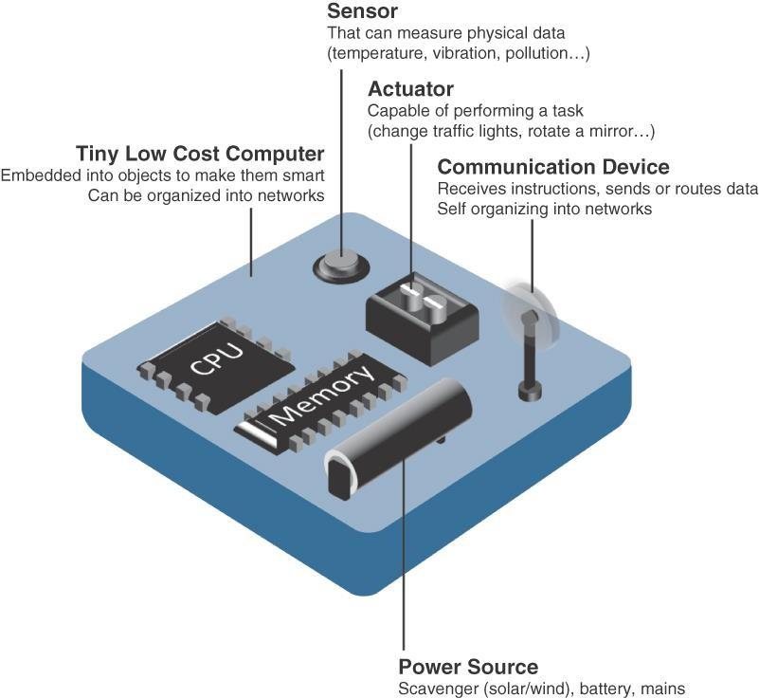
A smart object, is a device that has, at a minimum, the following four defining characteristics

Slide 28
Processing unit:
Some type of processing unit for
Acquiring data,
Processing and analyzing sensing information received by the sensor(s),
Coordinating control signals to any actuators, and
Controlling a variety of functions on the smart object, including the communication and power systems
The most common is a microcontroller because of its small form factor, flexibility, programming simplicity, ubiquity, low power consumption, and low cost

Slide 29
Sensor(s) and/or actuator(s):
A smart object is capable of interacting with the physical world through sensors and actuators
Communication device:
The communication unit is responsible for connecting a smart object with other smart objects and the outside world (via the network).
Communication devices for smart objects can be either
wired or wireless

Slide 30
Power source:
Smart objects have components that need to be powered.
The most significant power consumption usually comes from the communication unit of a smart object

Slide 31
Trends in Smart Objects
Size is decreasing
Power consumption is decreasing
Processing power is increasing
Communication capabilities are improving
Communication is being increasingly standardized

Slide 32
SENSOR NETWORKS
A sensor/actuator network (SANET), is a network of sensors that sense and measure their environment and/or actuators that act on their environment
The sensors and/or actuators in a SANET are capable of communicating and cooperating
Effective and well-coordinated communication and cooperation is a prominent challenge, primarily because the sensors and actuators in SANETs are diverse, heterogeneous, and resource-constrained

Slide 33
SANETs offer highly coordinated sensing and actuation capabilities.
Smart homes are a type of SANET that display this coordination between distributed sensors and actuators
For example, smart homes can have temperature sensors that are strategically networked with heating, ventilation, and air-conditioning (HVAC) actuators.
When a sensor detects a specified temperature, this can trigger an actuator to take action and heat or cool the home as needed.

Slide 34
Advantages and disadvantages that a wireless-based solution offers:
Advantages:
Greater deployment flexibility (especially in extreme environments or hard-to-reach places)
Simpler scaling to a large number of nodes
Lower implementation costs
Easier long-term maintenance
Effortless introduction of new sensor/actuator nodes
Better equipped to handle dynamic/rapid topology changes
Disadvantages:
Potentially less secure (for example, hijacked access points)
Typically lower transmission speeds
Greater level of impact/influence by environment

Slide 35
Wireless Sensor Networks (WSNs)
Wireless sensor networks are made up of wirelessly connected smart objects, which are sometimes referred to as motes.
The fact that there is no infrastructure to consider with WSNs is surely a powerful advantage for flexible
deployments, but there are a variety of design constraints to consider with these wirelessly connected smart objects

Slide 36
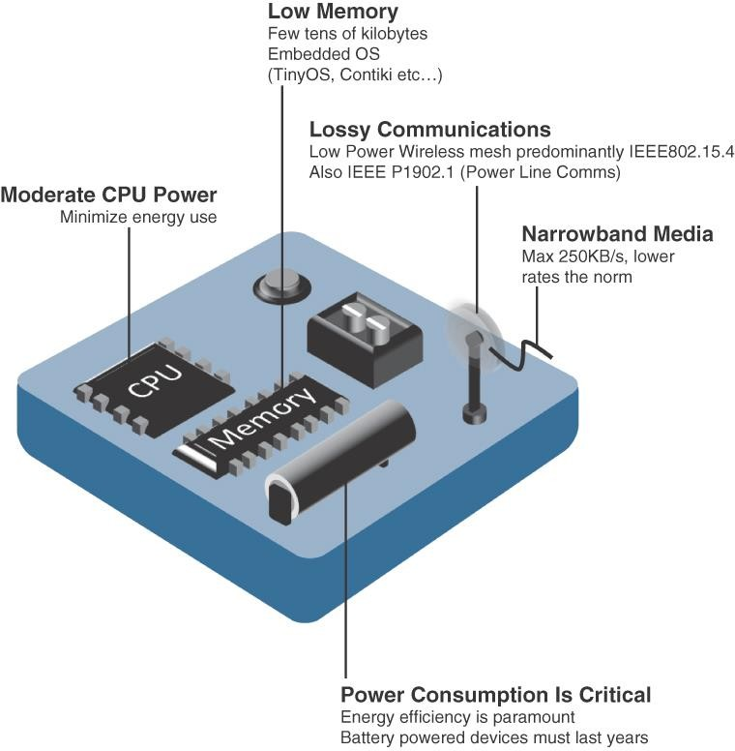

Slide 37
The following are some of the most significant limitations of the smart objects in WSNs:
Limited processing power
Limited memory
Lossy communication
Limited transmission speeds
Limited power
Note
Smart objects with limited processing, memory, power, and so on are often referred to as constrained nodes.

Slide 38
These limitations greatly influence how WSNs are designed, deployed, and utilized.
The fact that individual sensor nodes are typically so limited is a reason that they are often deployed in very large numbers.
As the cost of sensor nodes continues to decline, the ability to deploy highly redundant sensors becomes increasingly feasible.
Because many sensors are very inexpensive and correspondingly inaccurate, the ability to deploy smart objects redundantly allows for increased accuracy

Slide 39
Such large numbers of sensors permit the introduction of hierarchies of smart objects.
Such a hierarchy provides, among other organizational advantages, the ability to aggregate similar sensor readings from sensor nodes that are in close proximity to each other

Slide 40
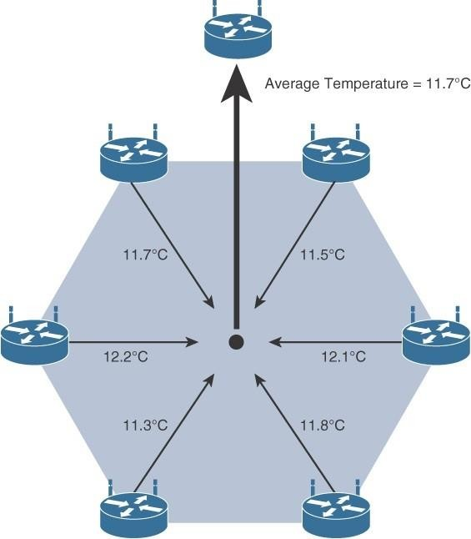
. Figure 3-9 shows an example of such a data aggregation function in a WSN where temperature readings from a logical grouping of temperature sensors are aggregated as an average temperature reading.
Figure 3-9 Data Aggregation in Wireless Sensor Networks

Slide 41
These data aggregation techniques are helpful in reducing the amount of overall traffic (and energy) inWSNs with very large numbers of deployed smart objects.
This data aggregation at the network edges is where fog and mist computing are critical IoT architectural elements needed to deliver the scale and performance required by so many IoT use cases

Slide 42
Wirelessly connected smart objects generally have one of the
following two communication patterns:
Event-driven:
Transmission of sensory information is triggered only when a smart object detects a particular event or predetermined threshold.
Periodic:
Transmission of sensory information occurs only at periodic intervals.
The decision of which of these communication schemes is used depends greatly on the specific application
For example: medical use cases

Slide 43
For example, in some medical use cases, sensors periodically send postoperative vitals, such as temperature or blood pressure readings. In other medical use cases, the same blood pressure or temperature readings are triggered to be sent only when certain critically low or high readings are measured.

Slide 44
Communication Protocols for Wireless Sensor Networks
There are literally thousands of different types of sensors and actuators.
WSNs are becoming increasingly heterogeneous, with more sophisticated interactions.
Any communication protocol must be able to scale to a large number of nodes.
Likewise, when selecting a communication protocol, you must carefully take into account the requirements of the specific application and consider any trade-offs the communication
protocol offers
between power consumption, maximum
transmission speed, range, tolerance for packet loss, topology optimization, security, and so on

Slide 45
They must also enable, as needed, the overlay of autonomous techniques (for example, self-organization, self-healing, self- configuration)
Wireless sensor networks interact with their environment. Sensors often produce large amounts of sensing and measurement data that needs to be processed. This data can be processed locally by the nodes of a WSN or across zero or more hierarchical levels in IoT networks.
Communication protocols need to facilitate routing and message handling for this data flow between sensor nodes as well as from sensor nodes to optional gateways, edge compute, or centralized cloud compute

Slide 46
standardization of communication protocols is a complicated task.
While there isn’t a single protocol solution, there is beginning to be some clear market convergence around several key communication protocols.

